Slide 1
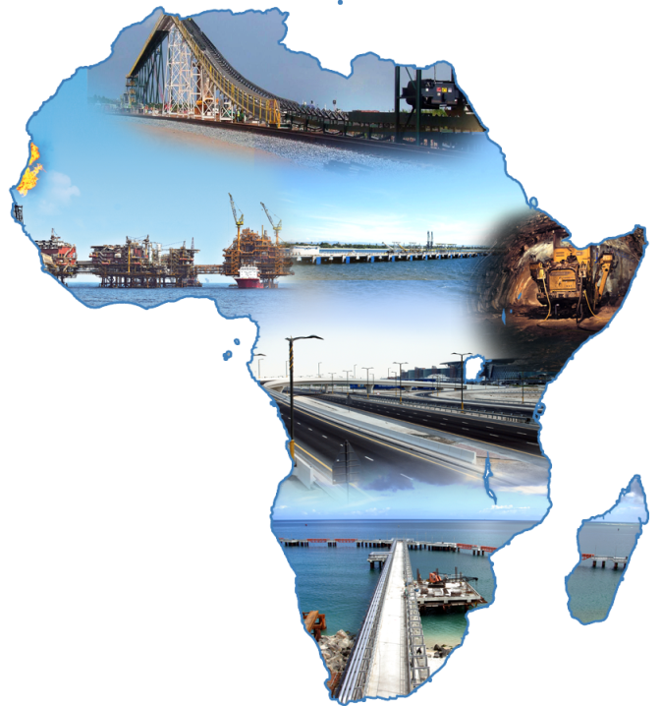
Collaborating to Address Africa’s Infrastructure Challenges K. Subrahmanian Vice Chairman and Managing Director, AFCONS Infrastructure Ltd. 11th March, 2014

Slide 2
Agenda
Africa
Global growth Driver
Infrastructure Requirements
Indian Infrastructure
Current involvement of Indian Infrastructure companies in Africa
Steps to Enhance presence of Indian Infrastructure companies in Africa

Slide 3
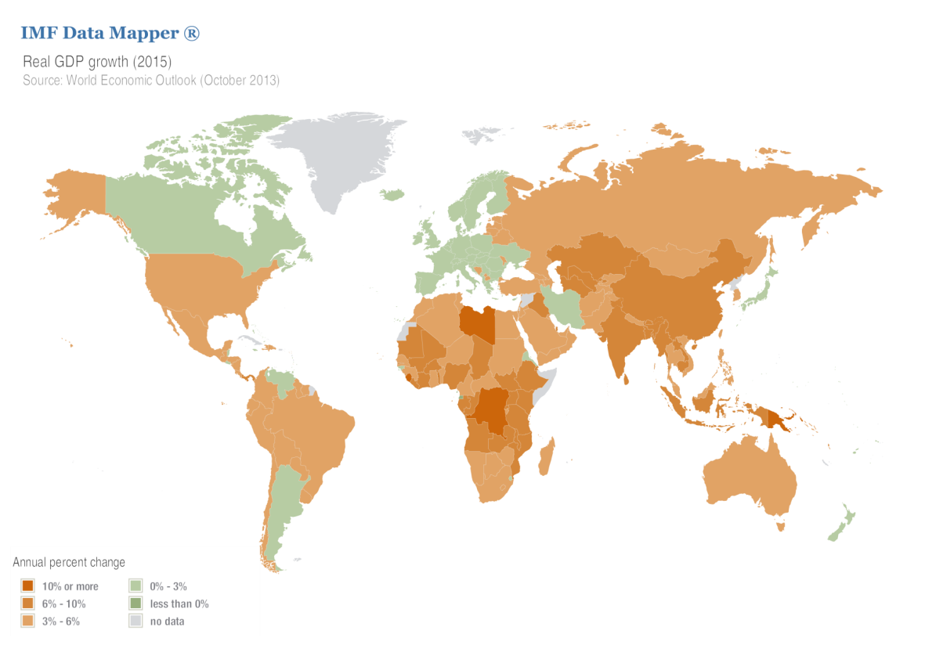
AFRICA – The next driver for global growth?
Global GDP Growth Rate
2015
AFRICA GDP growth rate expected to reach 4.7% this year and to 5% in 2015 with 15+ countries expected to grow by >6%¹
Growth driven by strong fundamentals
Rich resource base
Burgeoning middle class
0%
3%
>10%
¹ Source: IMF Data Mapper, Extracted on 3rd March, 2014

Slide 4
Infrastructure Needs – Here, there, everywhere (1/2)
1
2
Develop Resource Base
Demand from Growing Middle Class
Some of the Largest resource base across commodities including Copper, Bauxite, Iron, Coal, and Oil & Gas
Local and Global exploitation would require large scale infrastructure development
One of the fastest growing middle classes in the world, ~300 million (already as large as India’s)
Internal demand expected to drive economic growth
Ensuring availability and delivery would require Intra country and Intra Africa connectivity
Power generation and transmission to match the economic growth
Drivers for Infrastructure growth in place

Slide 5
Infrastructure Needs – Here, there, everywhere (2/2)
Poor availability of infrastructure² when compared to other developing and low income countries (LIC)
Resulting in higher tariffs, further increasing the cost of operations
Upto 10 times higher
Normalised Units | Sub-Saharan Africa LIC | Other LIC
Paved-road density | 31 | 134
Total road density | 137 | 211
Main-line density | 10 | 78
Generation Capacity | 37 | 326
Electricity Coverage | 16 | 41
Infrastructure Sector | Sub-Saharan Africa | Other developing regions
Power tariffs ($ per kilowatt-hour) | 0.02-0.46 | 0.05-0.10
Water tariffs ($ per cubic meter) | 0.86-6.56 | 0.03-0.60
Road freight tariffs ($ per ton-km) | 0.04-0.14 | 0.01-0.04
Hence as per a recent World Bank study upto $93 billion (15% of regions GDP) required annually to develop the infrastructure, with a third only for maintenance
Huge scope for Indian Infrastructure companies to address these needs
² Source: Yepes, Pierce, and Foster 2008.
Note: Road density is measured in kilometers per 100 square kilometers of arable land; generation capacity in megawatts per million population; electricity coverage in percentage of population

Slide 6
Agenda
Africa
Global growth Driver
Infrastructure Requirements
Indian Infrastructure
Current involvement of Indian Infrastructure companies in Africa
Steps to Enhance presence of Indian Infrastructure companies in Africa

Slide 7
Indian companies have developed technical capabilities to match the best in the world
Since 1998, the extent of Infrastructure development has been matched only by China
NHAI
Metro
Airport etc
Most of these projects have been executed by local companies (individually or JVs)
Hence developed extensive expertise in complex project delivery
Project Delivery approach
Large scale projects like NHAI and DMRC delivered on time
Followed an inclusive approach for project execution, hence we have an inclusive mindset

Slide 8
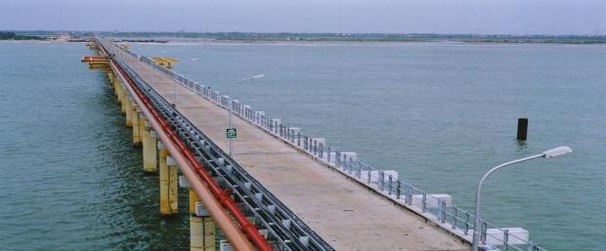
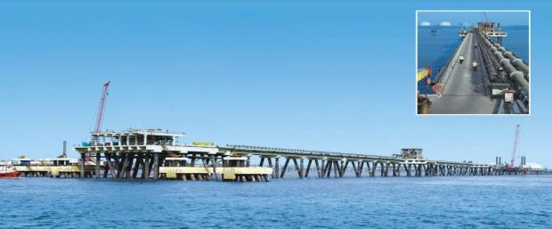
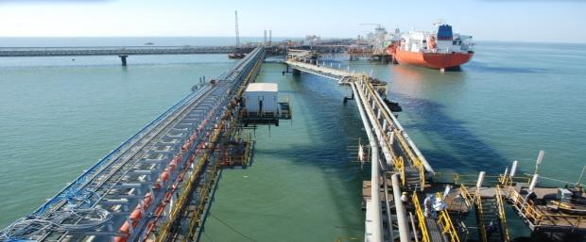
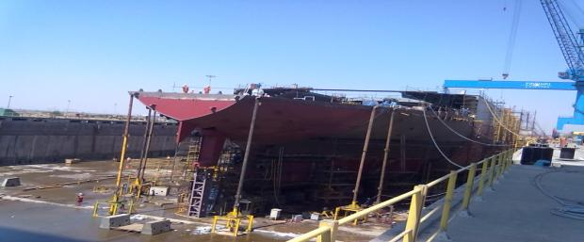
Indian Infrastructure firms have delivered large scale complex jobs across geographies (1/4)
Marine Infrastructure
Crude Unloading Jetty
Nagapattinam
LNG Jetty
Dahej, Gujarat
A1 Berth – Jamnagar
Reliance
Conversion of Wet Dock to Dry Dock Pipavav

Slide 9
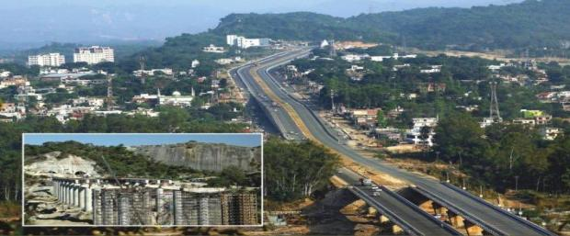
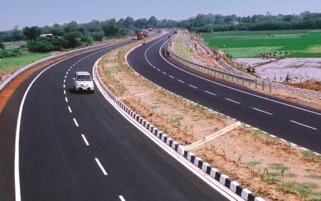
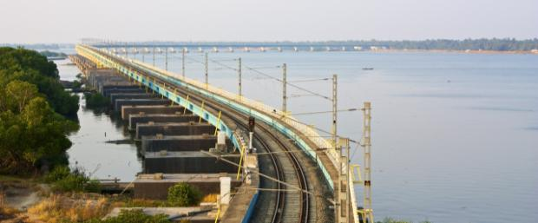
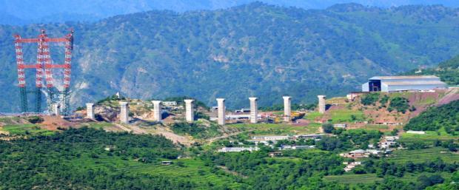
Indian Infrastructure firms have delivered large scale complex jobs across geographies (2/4)
Road Infrastructure
Jammu Udhampur – 4 laning
Jammu & Kashmir
Ullundurpet – 4 laning
Tamil Nadu
Railway Infrastructure
Railway Bridge (4.6 KM)– Vallarpadam
Kerala, The longest railway bridge in India
Bridge over Chenab Valley
Jammu & Kashmir, on completion one of the tallest railway arch bridge in the world

Slide 10
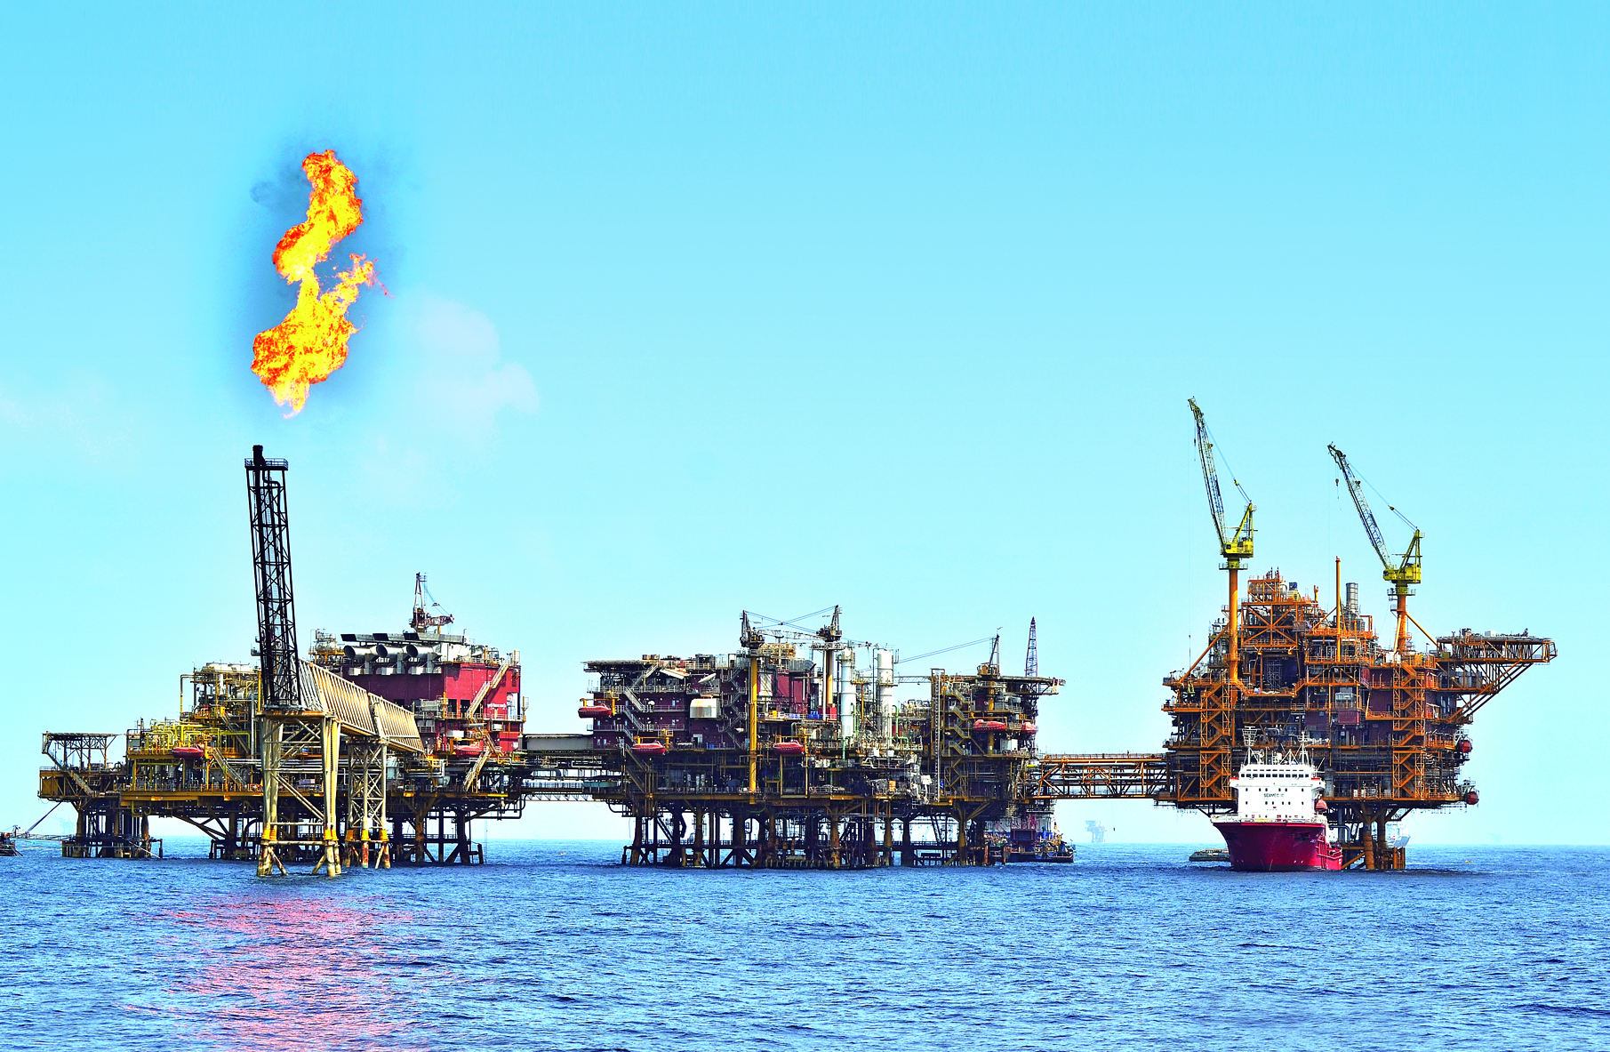
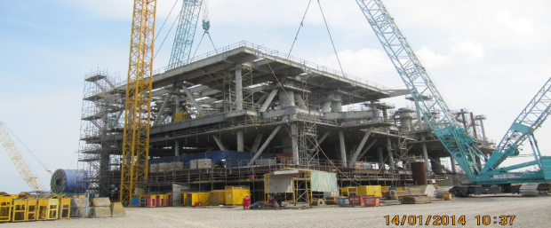
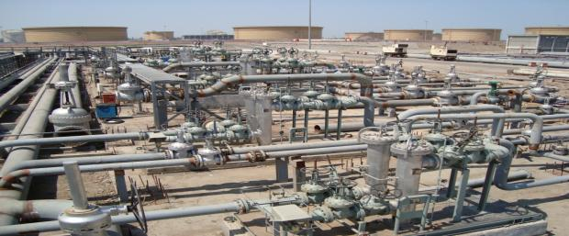
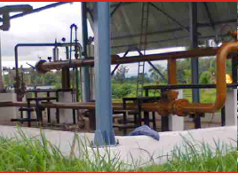
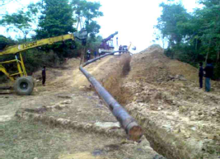
Indian Infrastructure firms have delivered large scale complex jobs across geographies (3/4)
Oil & Gas
ICPR Process Platform
ONGC
HRD Process Platform
ONGC
Civil and Structural works, Refinery Works
Jamnagar
Assam Pipeline Project
ONGC

Slide 11
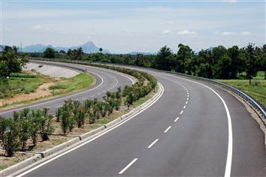
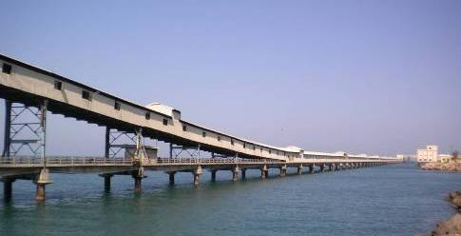
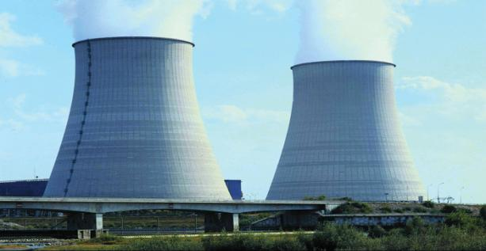
Indian Infrastructure firms have delivered large scale complex jobs across geographies (4/4)
Krishnagiri-Thopur (Tamil Nadu)
Tuticorin Port
NeyVeli Thermal Power Plant, Tamil Nade
Mumbai Airport

Slide 12
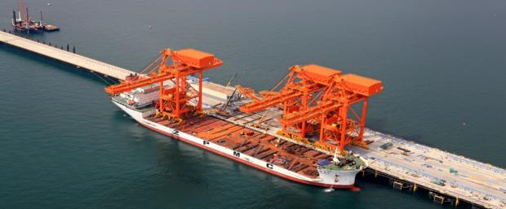
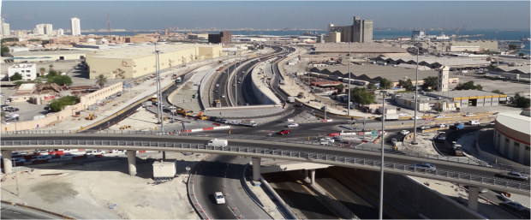
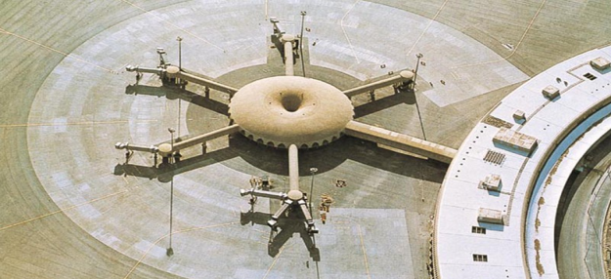
Competing against the best in the world, Indian companies have delivered complex projects overseas
Bulk Jetty, Port of Sohar
Oman
Mina Salman Interchange
Bahrain
Abu Dhabi, Airport Terminal

Slide 13
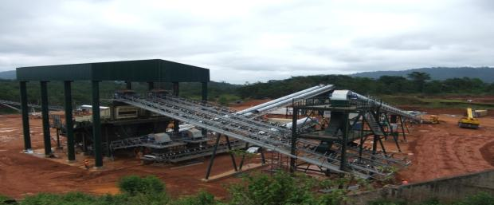
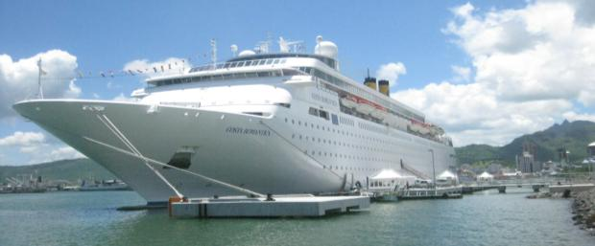
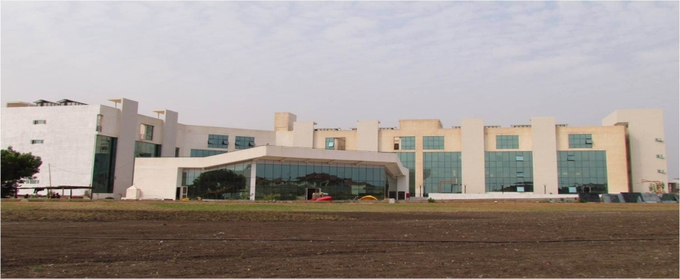
… and have delivered jobs in Africa as well (2/2)
Material Handling Facilities
Liberia
Cruise Berth
Mauritius
Ghana President’s Office
Ghana
DPS International School
Ghana

Slide 14
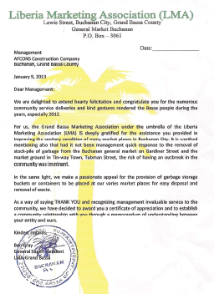
Indian Infrastructure Companies have develop an inclusive approach to project execution
Development of local workforce
Drinking water
Developed local skilled labour through intensive training in construction & other skills
Engaged substantial local manpower
Training of locals (incl not working at site) to improve skill levels
Water supply is scarce in the areas where AFCONS was working
Hence handpumps were installed in the 50KM radius around the site
Liberia Market Association
Construction for locals
Construction of Market for small vendors in Buchanan
Helped maintain hygienic conditions in Buchannan.
AFCONS constructed a school building
Education material was also provided to the children
Community centre at Zolowee Village, Nimba County
Construction of 4 community circular huts
3 bus shelters with facilities
Medical facilities for workers and locals

Slide 15
Agenda
Africa
Global growth Driver
Infrastructure Requirements
Indian Infrastructure
Current involvement of Indian Infrastructure companies in Africa
Steps to Enhance presence of Indian Infrastructure companies in Africa

Slide 16
Presence of Indian Infrastructure players in Africa Infrastructure Projects
Indian presence is not commensurate with the capabilities and technical know how
Market Share by country in Africa Construction³
Scattered presence across the continent⁴
Presence in Hydro, Clean Energy, T&D, Roads
Projects >$50 million, under execution (i.e broken ground but not yet commissioned) as on 1st June, 2013
³ Source: Deloitte’s “African Construction Trends Report 2013”, Published Nov, 2013
⁴ Source: AFCONS Internal research

Slide 17
Given India’s strong historical linkages, rich technical expertise and Africa‘s attractive market, what is the gap?
Funding
Visibility into Africa
Government of India has been proactively supporting inclusive development of Africa over period of time, but a few areas of improvement that have emerged include
Borrower countries apprehensive due to perceived delays in the process involved
Dependence on Sovereign guarantee
Private Funding not yet into infrastructure
Perceived risk in long term is high
Lack of local funding capabilities
Given the sheer size of Africa with 55 countries and large number of opportunities
Challenging to identify the projects of local priority
Though vision plans have been formed , but there is limited information on specific projects
Long time taking processes from initiation to award, involving multiple local and federal agencies

Slide 18
Proposed Steps for enhancing Indian presence in Africa (1/2)
Indian Government
African Governments
Strengthening of funding approval process
Innovative funding mechanisms including
Barter based project approvals
Alternative security acceptances(alternative to Sovereign Guarantee)
Joint Government – Industry strategy for certain large scale infrastructure developments in Africa
Encourage / Facilitate cash rich public / private companies to invest in Africa into strategically important fields / countries in Africa
Identification and sharing of priority projects through Local Embassies, ministry websites and Indian government
Internal processes regarding approval of sovereign guarantee to be streamlined to improve the pace of approval
Single point of contact for project approval from initiation to award
Through mutual discussion between Indian & African governments, identification of projects exclusive for India

Slide 19
Proposed Steps for enhancing Indian presence in Africa (2/2)
Industry
Focus on Execution excellence
Inclusive development

Slide 20
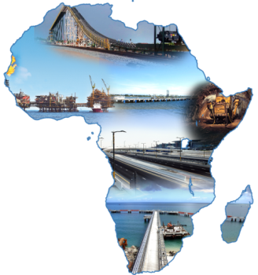
Summary
1
Large Scale Infrastructure Opportunities
Infrastructure projects valued $223+ billion underway, with $93 billion required to be spend each year on infrastructure
2
Indian Participation in Africa Infrastructure
Indian presence is not commensurate with the capabilities and technical expertise
3
Steps to improve Indian presence
Indian Government
Streamlining of funding approval process to reduce approval time
Making available more innovative means of finance
Facilitation of Barter based project approvals
African Governments
Improved visibility of priority projects
Identification of projects on an exclusive basis for India
Single point of contact
Industry
Focus on Execution excellence
Inclusive development

Slide 21
Thank You
www.afcons.com

